Slide 1

Do Schools Really Consider Students’ Success When Allocating Expenditures?
Group “SASI & Co”:
Samuel Bull, Aminata Sanogo,
Sabina Seredneva, Ian Ustanik
IST 718 - 5/12/2021

Slide 2

GOAL
Identifying the relationship between fund
management of high performing schools
and their students achievements.
“A well informed citizenry is the best defense against tyranny” -Thomas Jefferson*
Public critique
No specific financial spending model
Importance for students
Future of the US
Notes:
Goal Title: Identifying the correlation between fund management of high performing schools and their students achievements

Slide 3
Dataset Description
Data Sources:
School Finance Data
Annual survey of school systems financial tables
https://www.census.gov/programs-surveys/school-finances/data/tables.html
Graduation Rates
ED Data Express: Percentage of students who graduated with a regular high school diploma
https://eddataexpress.ed.gov/dashboard/title-i-part-a
National ACGR
National Center for Educational Statistics: Public high school 4-year adjusted cohort graduation rate (ACGR)
https://nces.ed.gov/programs/digest/d19/tables/dt19_219.46.asp
Combined Dataset:
Initial dimensions: 101,009 observations X 150 variables

Slide 4
Feature Engineering
CONUM, SCHLEV, STATES
Dummy variables
Graduation Rates
Compared to national averages
Boolean (1/0)
TOTALREV/TOTALEXP/Debt
Whole number amounts
Revenue & expenditure components
Ratios
Combined Dataset:
Clean data dimensions:
94,547 observations X 3,298 variables
Dependent variable: Graduation class

Slide 5
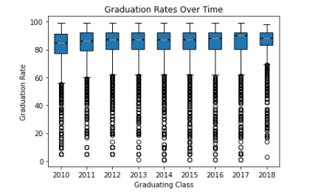
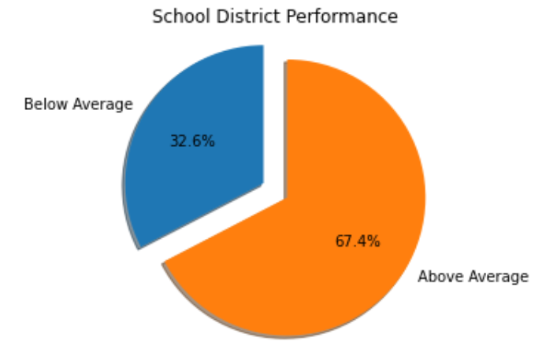
Descriptive Statistics
It was determined that an appropriate measure of school district performance was graduation rate.
A binary classification was developed to classify school districts that fell above or below the national graduation rate for that school year.

Slide 6
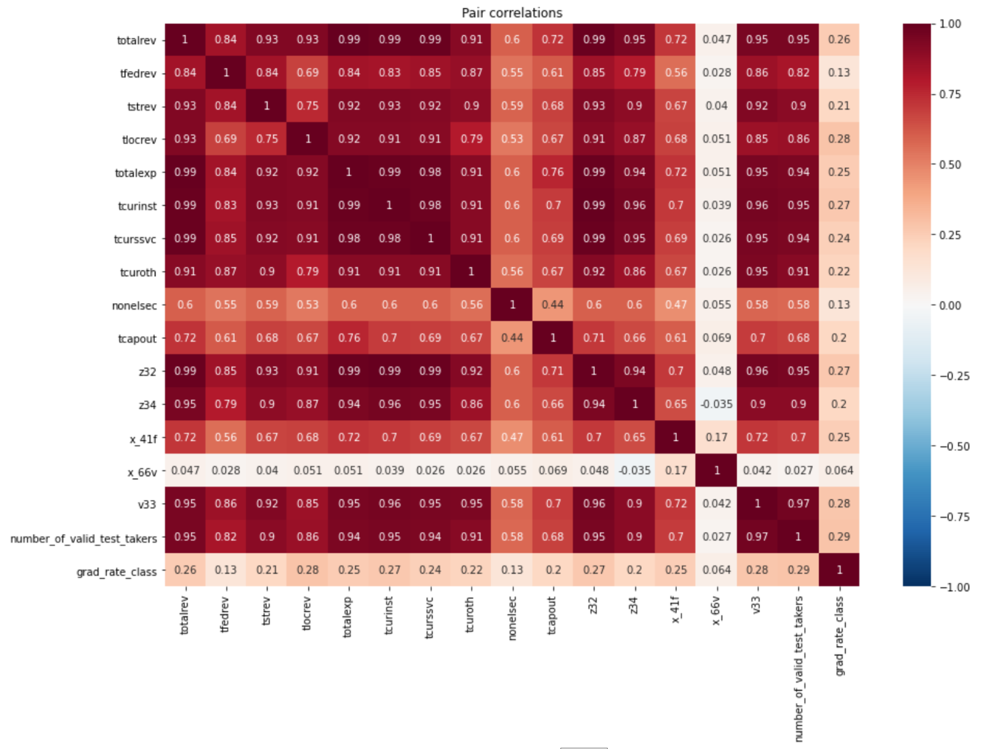
Descriptive Statistics(cont)
Best correlation with:
Number of valid test takers
Fall membership
Total revenue
Total revenue from local sources
Total current spending for instruction
Total salaries and wages

Slide 7
Models Description
Random Forest
Logistic Regression (Lasso)
K-means Clustering
Used each variable in cleansed dataset apart from GEOID, year, and IDCENSUS.
Aim: To analyse Grad_Rate_Class accurately (0/1)
Sets utilized:
Training = 60% (56,693 Observations)
Validation = 30% (28,398 Observations)
Testing = 10% (9,456 Observations)

Slide 8
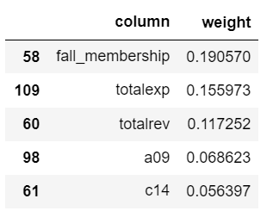
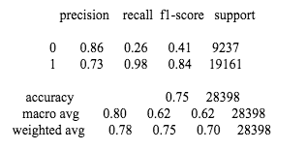
Random Forest:
Number of trees: 20
Feature importance:
Validation BCE Random Forest Model AUC: 0.8266783813294203
Notes:
accuracy is 0.75, most

Slide 9
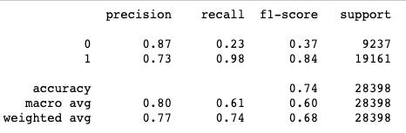
Logistic Regression:
Lasso
Regression utilizing elasticNetRegression=1,
regParam=0 and maxIter=100
Validation AUC:

Slide 10

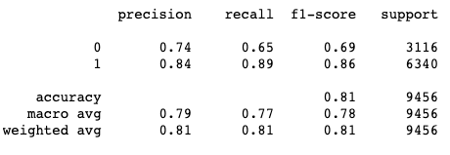
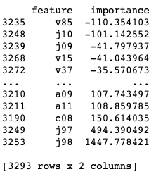
Evaluation Metrics -
Best Model
After comparing the two models run, we concluded that the Lasso (Elastic net) Regression model was the better of the two.
Best Method AUC:
Important Features (Top Positive and Negative)
J98 (State Payments on Behalf of Nonelementary/Secondary Programs): 1447.78
V85 (Nonspecified Support Services): -110.35

Slide 11
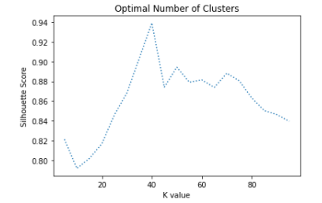
K-means Clustering
Performed K-means clustering to compare the features of similarly performing schools (grad_rate_class = 0/1).
Utilized Silhouette Coefficient for determining optimal number of clusters (~40)
Squared Euclidean Distance → 0.9391352917730235
Analyzed cluster results which grouped together schools which had similar values for important features.

Slide 12
Conclusions (Insights & Advice)
POSITIVE
Schools that engaged in more lunch and textbook revenues tended to perform better → (Offer more of these programs to create an equitable learning environment)
Schools that offered gifted and talented programs tended to perform better → (Adding alternative educational programs for higher performing students would help students reach their higher potential)
Schools that received more state funding for nonelementary-secondary programs and noninstructional and nonbenefits tended to perform better → (The more state funded programs, the better)
NEGATIVE
Schools that were burdened with higher support services expenditures tended to perform worse → (Look to cut operational costs if possible)
Schools that spent more on general benefits tended to perform worse → (Take a more conservative approach when choosing employee benefits)
Schools that paid higher salaries to administrators and employees other than teachers tended to perform worse → (Perhaps school districts should think twice about offering bloated contracts to administrators and pay teachers more)

Slide 13
Potential Future work
Limited access to additional statistics about school districts (such as faculty per student)
More compute power (easily compute more complex models for our large dataset)

Slide 14
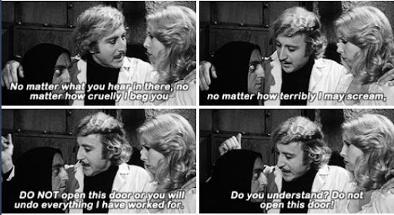
Thank you for your attention!
Questions?
WHILE WORKING ON PROJECT:

